Slide 1
Introduction to Machine Learning
A Neuron
(also called Perceptrons)

Slide 2
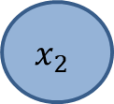
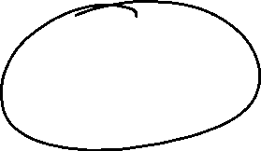
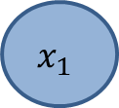
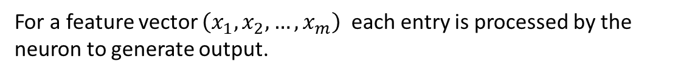
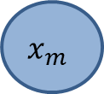

Concept of a Neuron
For a feature vector $\left(x_{1},x_{2},…,x_{m}\right)$ each entry is processed by the neuron to generate output.
$$x_{1}$$
$$x_{2}$$
Neuron
Output/
Activation
…
$$x_{m}$$
The output of a neuron is called Activation
Note: x a row vector with shape (1,m)

Slide 3
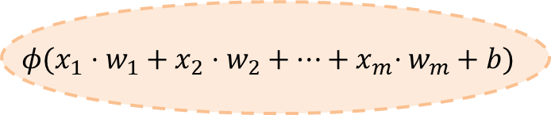
Weights, Bias and Activation Function
This is the basic processing function of a Neuron. The real number b is called Bias. The function $φ$ is called Activation Function.
$$x_{1}$$
$$x_{2}$$
$$φ(x_{1}⋅w_{1}+x_{2}⋅w_{2}+…{+ x}_{m}⋅w_{m}+b)$$
Output
…
$$x_{m}$$
Note: In our next exercises, we use $φ\left(x\right)=x,$to keep things simple. Notation: $φ$ = linear

Slide 4
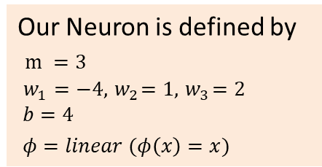
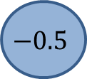
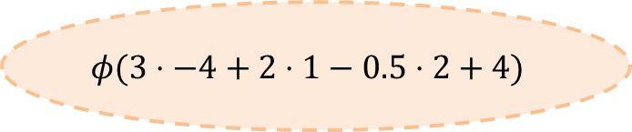
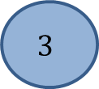




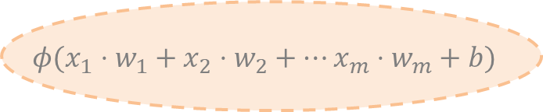
Example
Our Neuron is defined by
$m =3$
$w_{1}=−4, { w}_{2}=1, { w}_{3}=2$
$$b=4$$
$φ=linear (φ\left(x\right)=x)$
$$3$$
$$⋅−4$$
2
$$φ(3⋅−4+2⋅1−0.5⋅2+4)$$
$$⋅1$$
$$−7$$
$$⋅2$$
$$−0.5$$
Remember:
$$φ(x_{1}⋅w_{1}+x_{2}⋅w_{2}+…x_{m}⋅w_{m}+b)$$

Slide 5

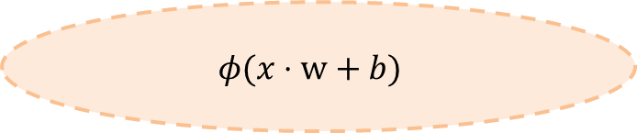

Activation and Bias
If we write the weights as a column vector $w=\left(w_{1},…, w_{m}\right)$ the formular can be written in simpler form.
$$x_{1}$$
$$x_{2}$$
$$φ(x⋅w+b)$$
Output
…
$$x_{m}$$
Note: x is a row vector.

Slide 6

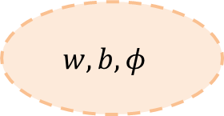

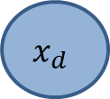
Notation
A Neuron is defined by $w,b, φ$
$$x_{1}$$
$$x_{2}$$
$$w, b,φ$$
Output
…
$$x_{d}$$

Slide 7
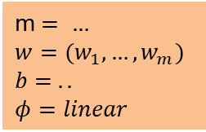
Notation with values
If we want to see the values of a Neuron, we will write it as box. If we use $φ\left(x\right)=x$we write $φ=linear$
$$x_{1}$$
$$x_{2}$$
m $= …$
$$w=(w_{1},…, w_{m})$$
$$b= ..$$
$$φ=linear$$
Output
…
$$x_{m}$$

Slide 8
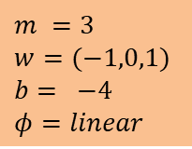
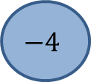
Example
$$3$$
2
$$m =3$$
$$w=(−1,0,1)$$
$$b= −4$$
$$φ=linear$$
$$−4$$

Slide 9

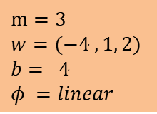
Exercise
$$30$$
20
$$m=3$$
$$w=(−4 ,1, 2)$$
$$b= 4$$
$$φ =linear$$
$$−0.5$$

Slide 10
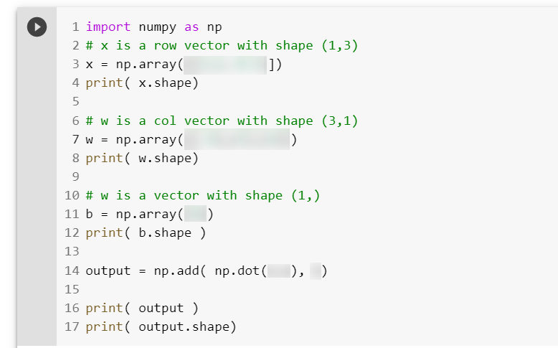
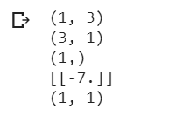
Exercise: Model the Neuron from slide „Example“ in Phyton to get the desired output. Explain the output!
Desired Output

Slide 11
Very Important
Feature vectors a row vectors!
Weights are column vectors!
w
x
+
b
„Zeilenvektor <skalarproduct mit> Spaltenvektor <plus> b“

Slide 12

Terms and Notes
Terms
the column vector $w$is called kernel of the neuron
the number $b$is called bias of the neuron
Notes
So, in our simple example
$x$must have shape (1,m)
$w$must have shape (m,1)
$b$must have shape (1,)

